Slide 1
I2K 2023: Visual batch QC in Fiji using MoBIE
Dominik Kutra, Christian Tischer
Data Science Centre, EMBL

Slide 2
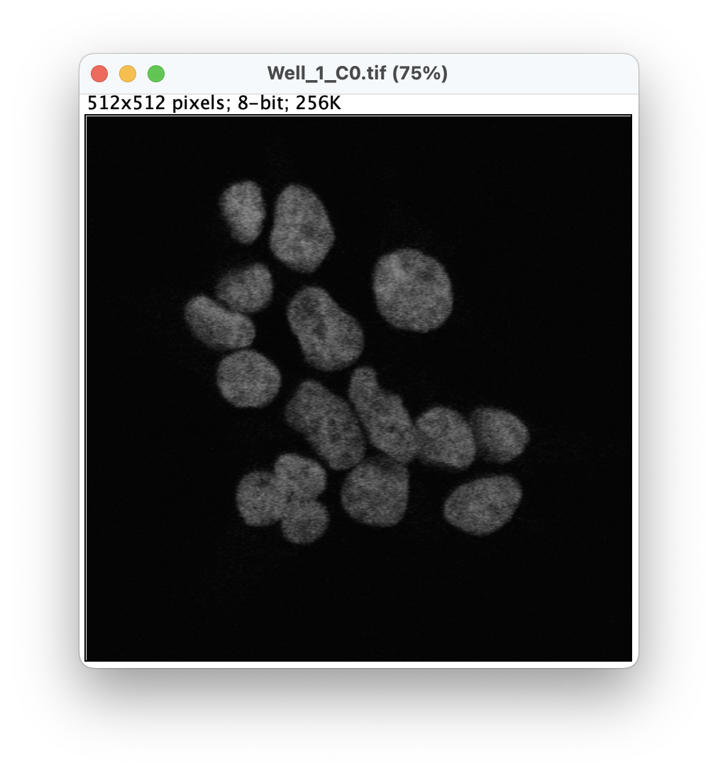


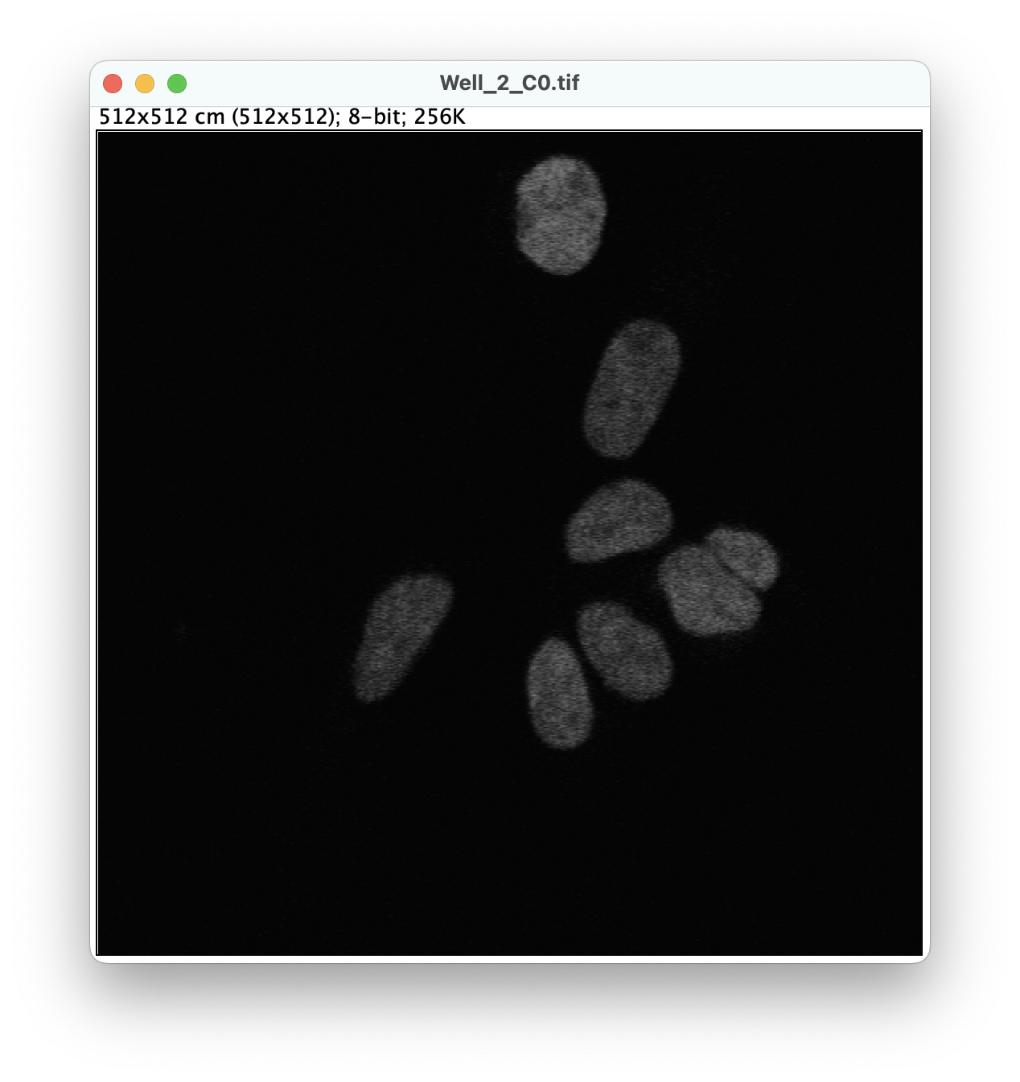

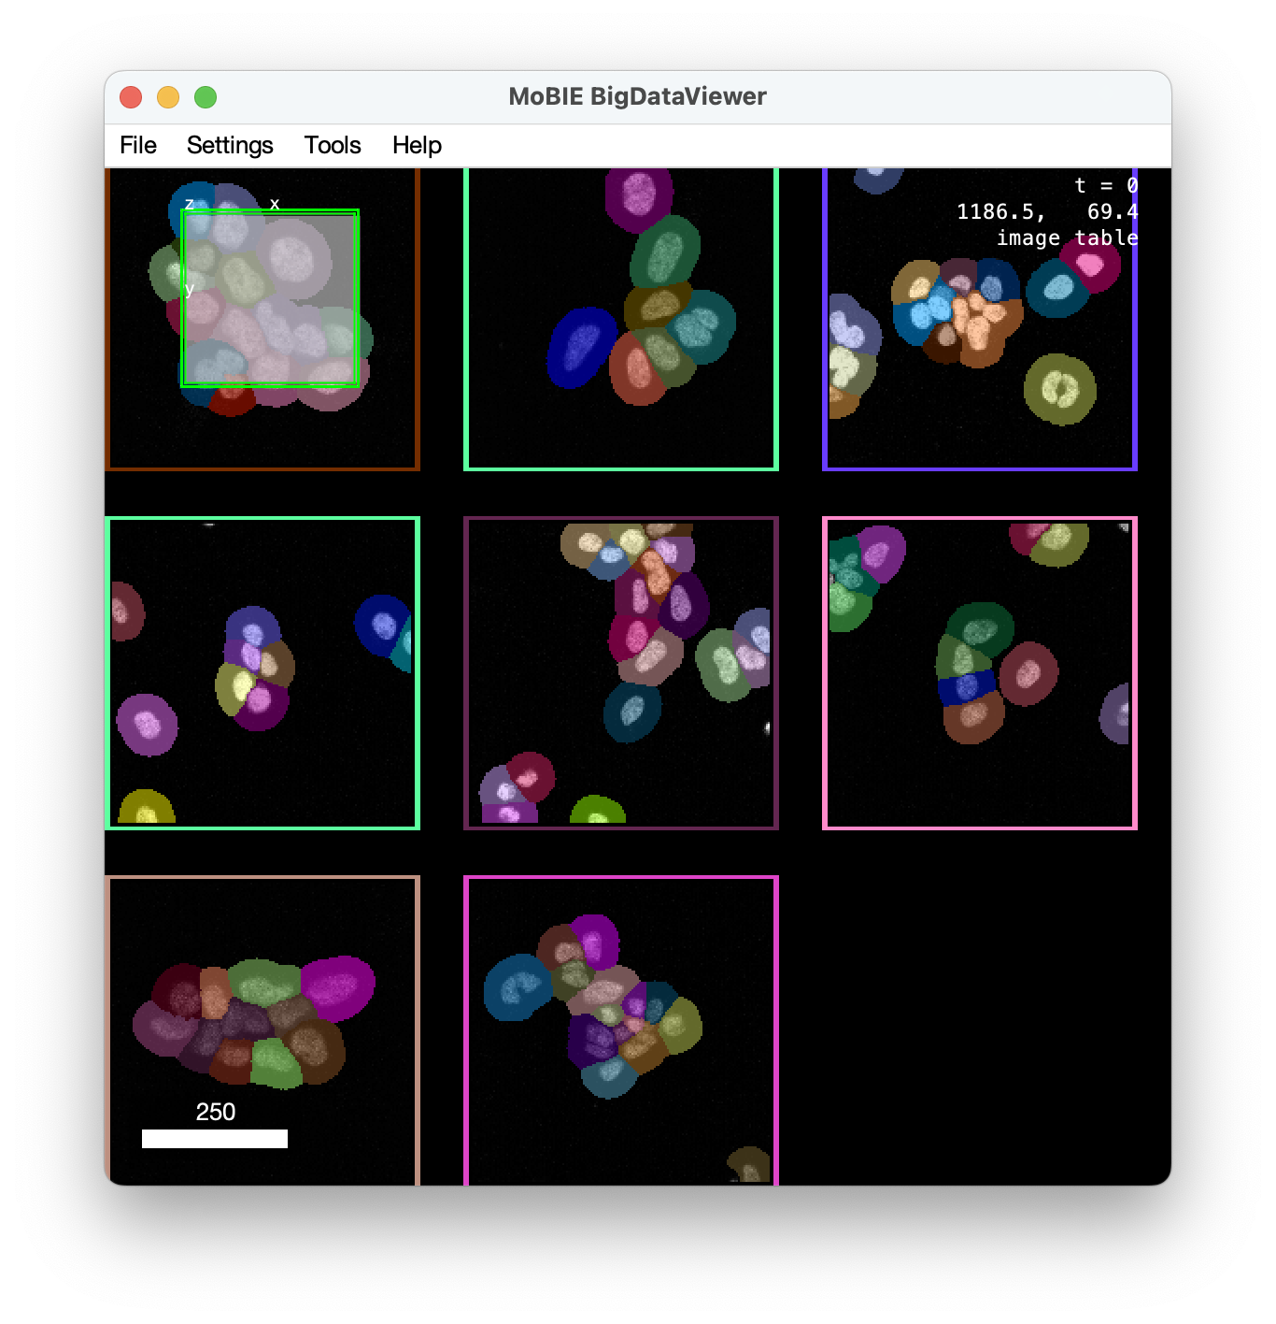
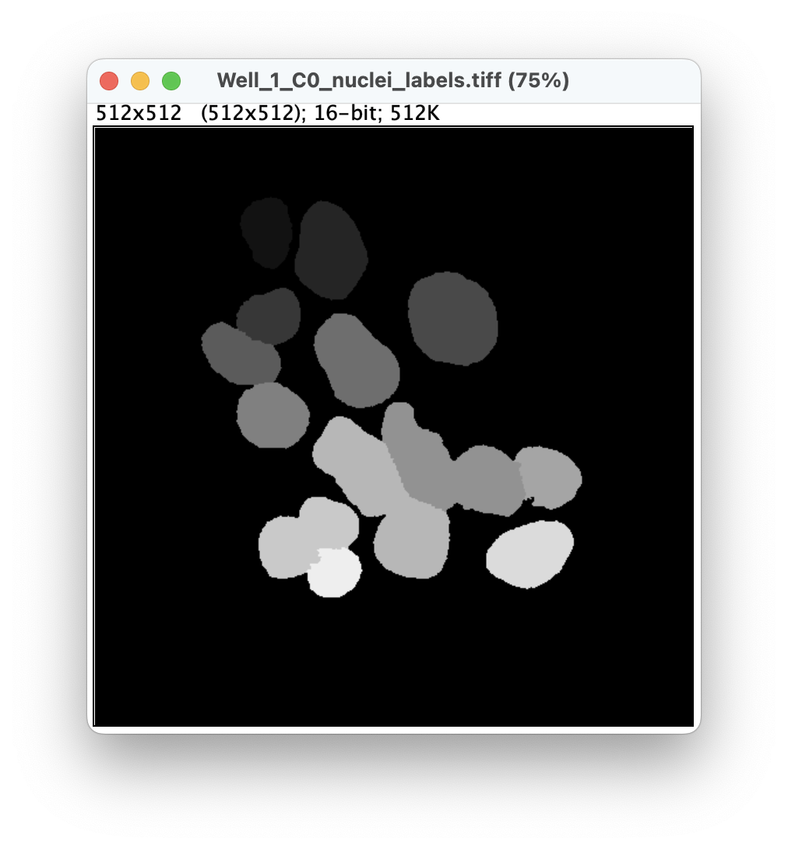
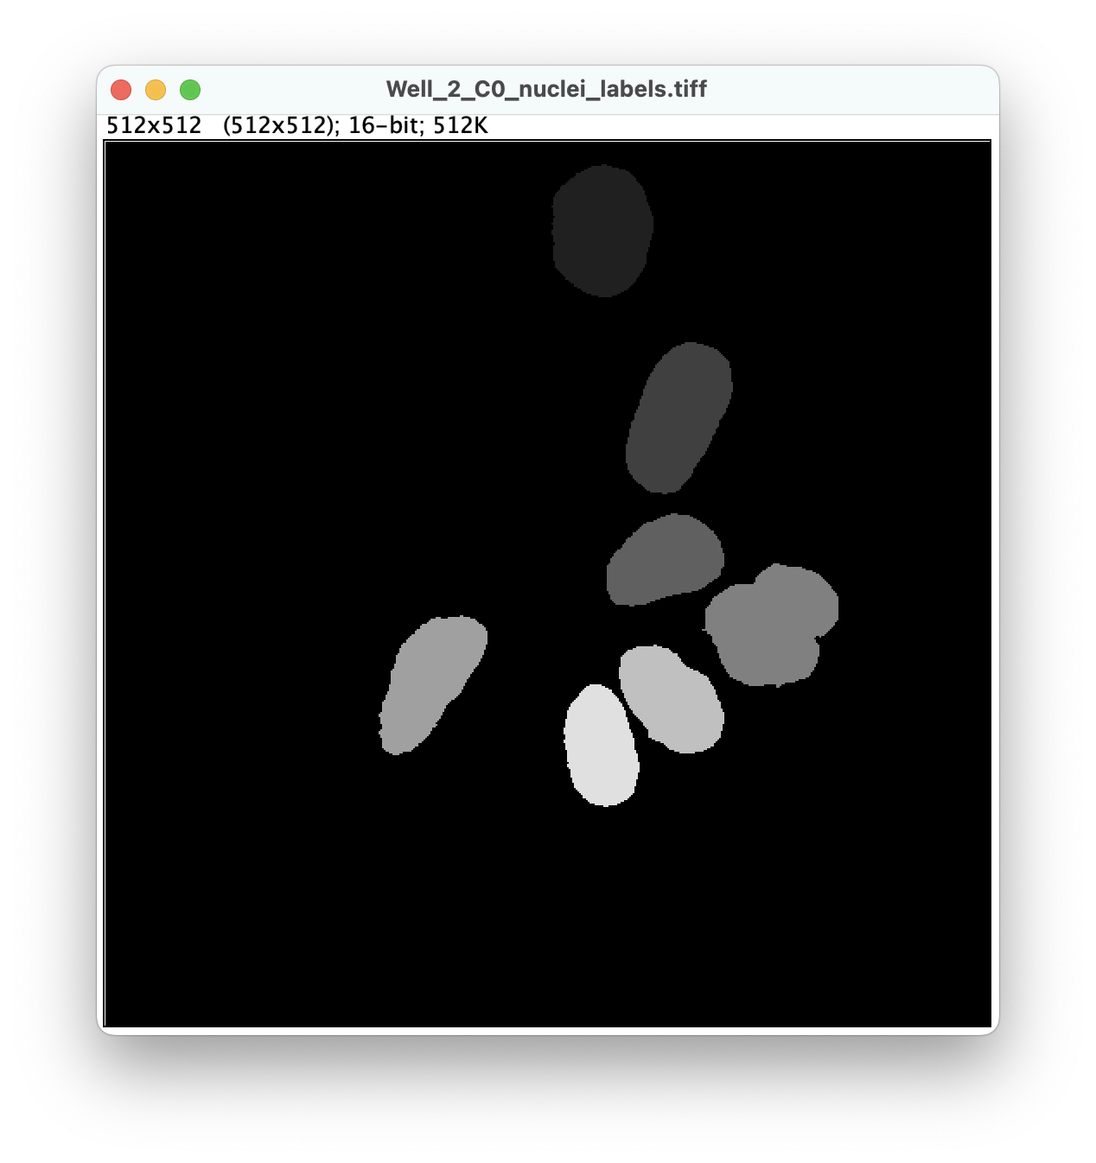


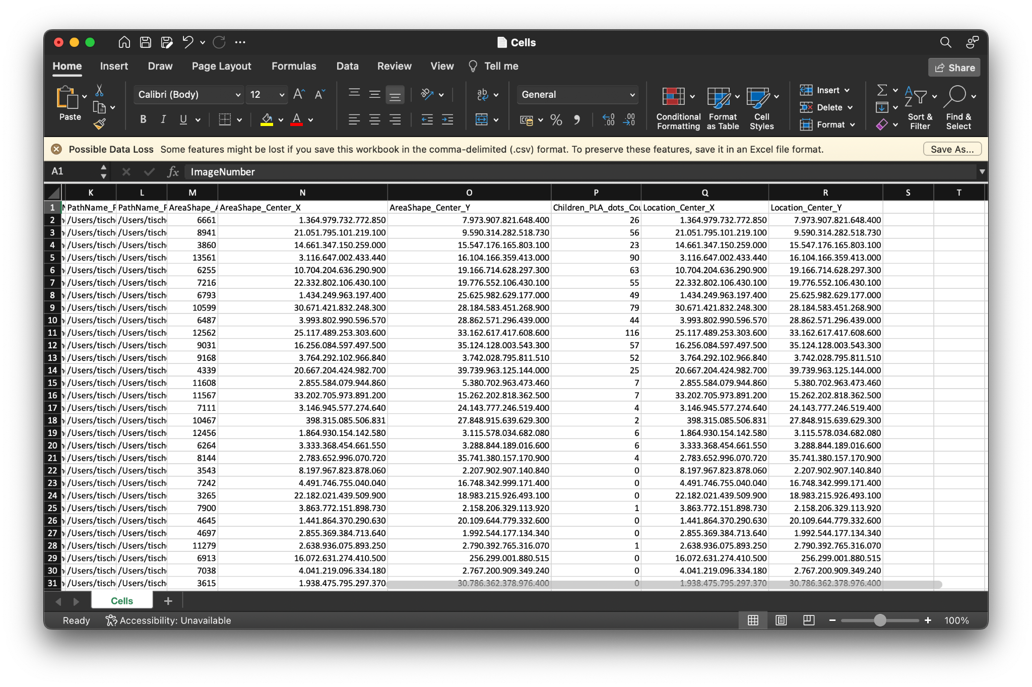
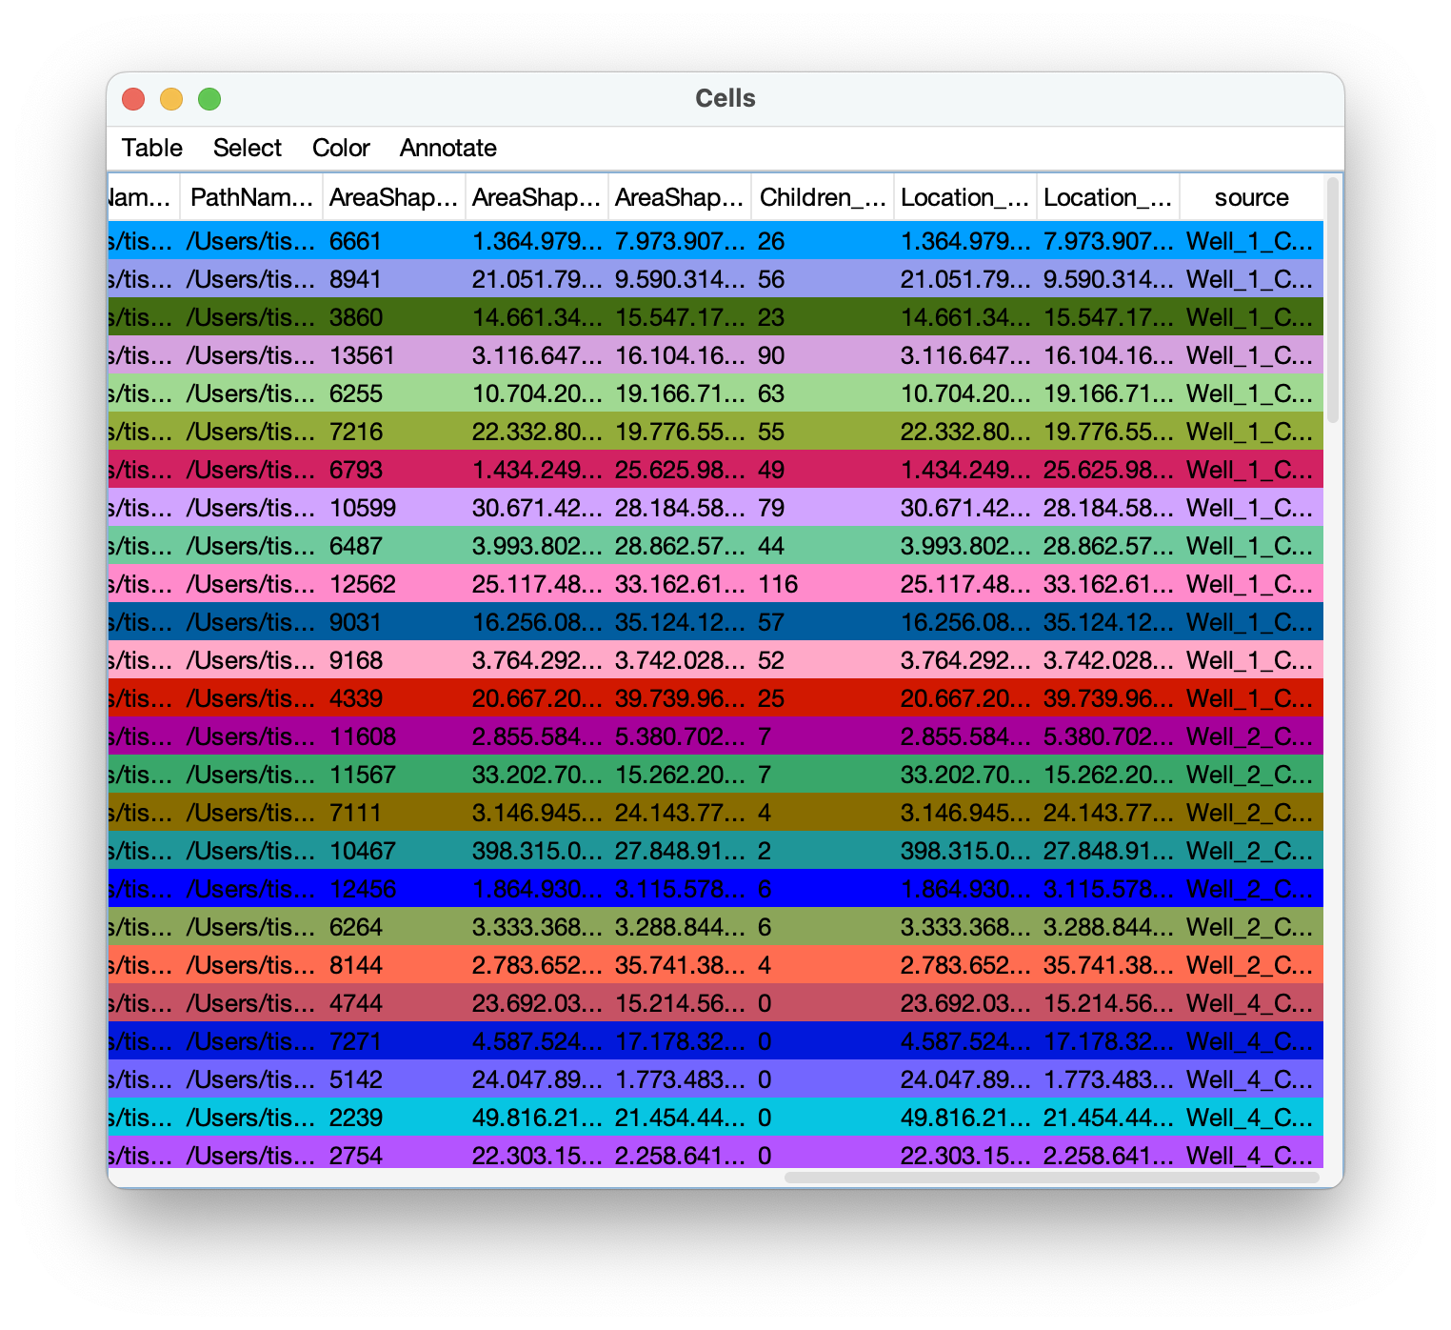
Image batch analysis
Lots of data
Visual batch QC
…

Slide 3
Image batch analysis
Images, segmentations, tables
Visual batch QC
…

